Slide 1
SOCIAL NetWORKING
Channel Overview

Slide 2
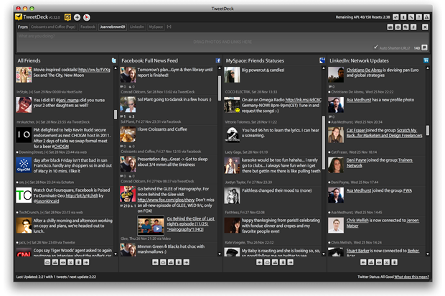
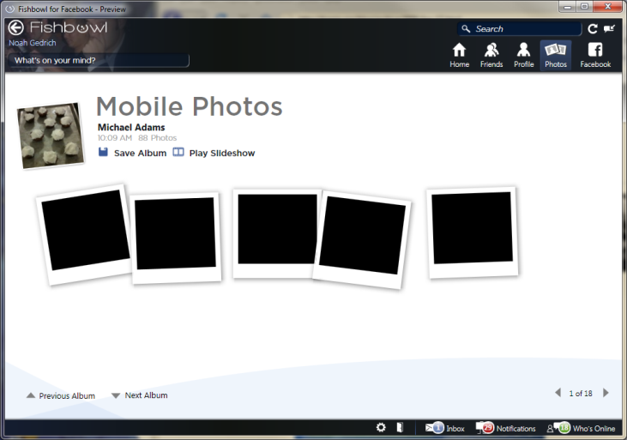
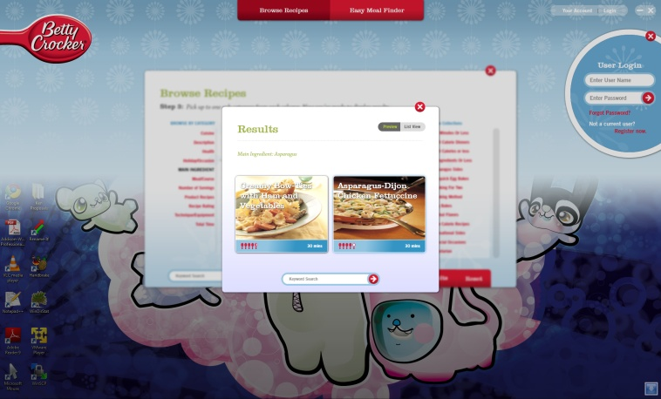
Channel Opportunity
Social Networking Applications
Connect with users directly in their social space.
Leverage core technology and enhance client site
Simplify and increase user registrations
Widen client reach through social channel distribution
Custom applications
Implement 3rd party hosted solutions

Slide 3
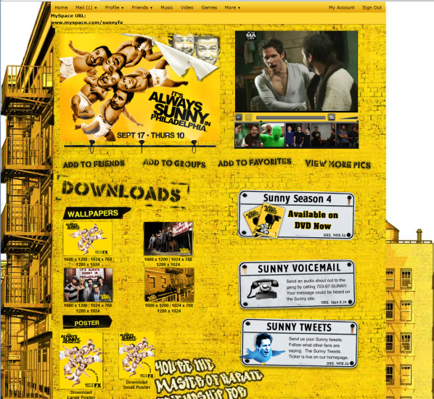
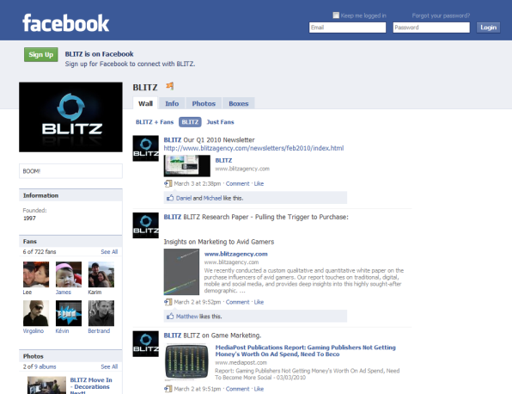
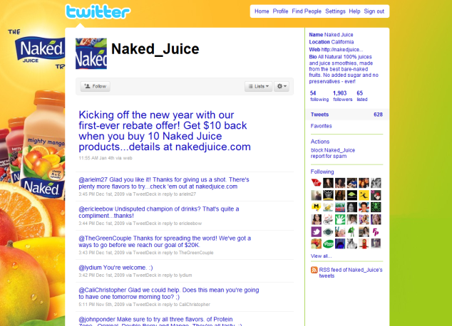
Example 1- Social Space
Communicate with users in their social space
Facebook fan page
Myspace page
Twitter feed
Builds brand loyalty and brand awareness

Slide 4
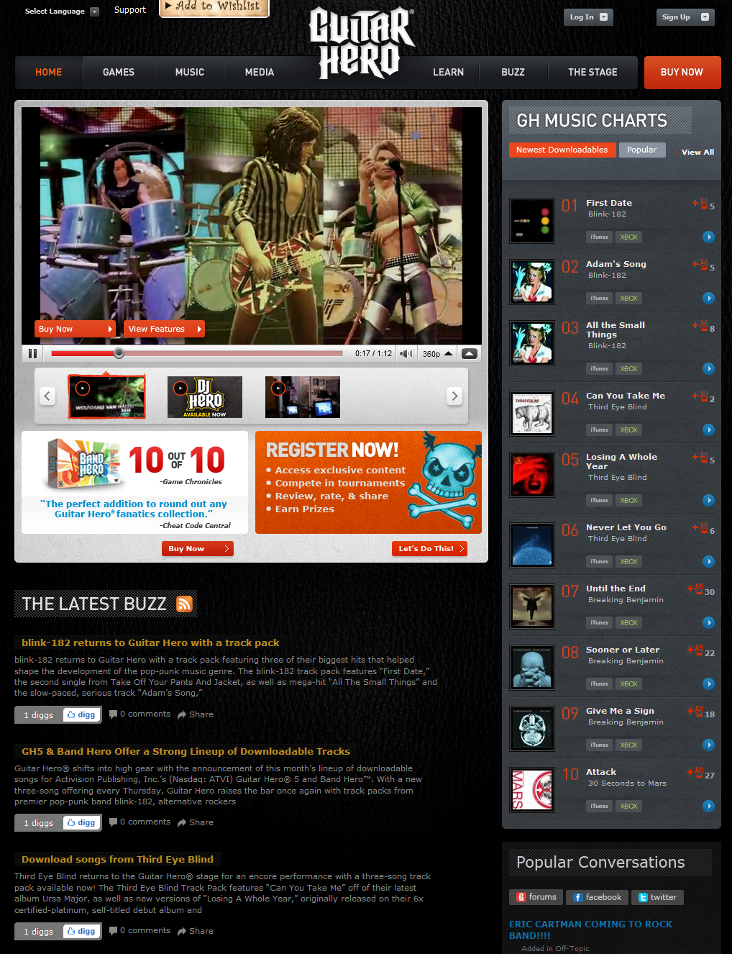
Example 2: Leverage Core Technologies
Deliver video content through YouTube API
Save bandwidth costs and distribute your content through YouTube, Improve search relevance on Youtube.
Digg API to bring relevant content to your site
Promote your content through the Digg network
Facebook Connect to utilize user profile info
Interact and share based on personal contacts and interests

Slide 5
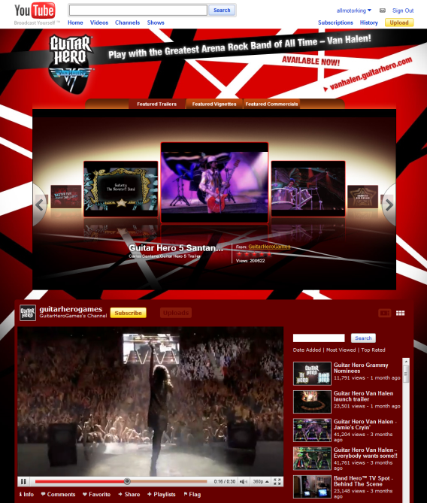
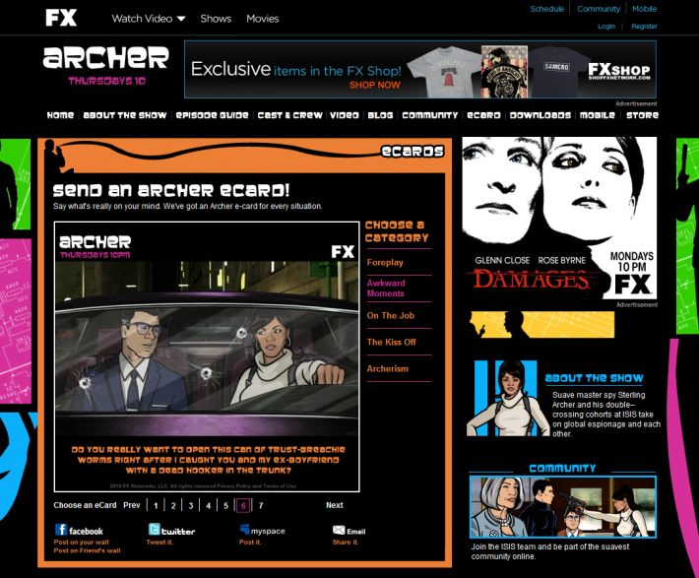
Example 3: Widen Client Reach
Pushing your content through social networking sites
Building a channel on YouTube with subscribers
Digg-ing articles on your site increases visibility
Variety of “share” options to push content

Slide 6
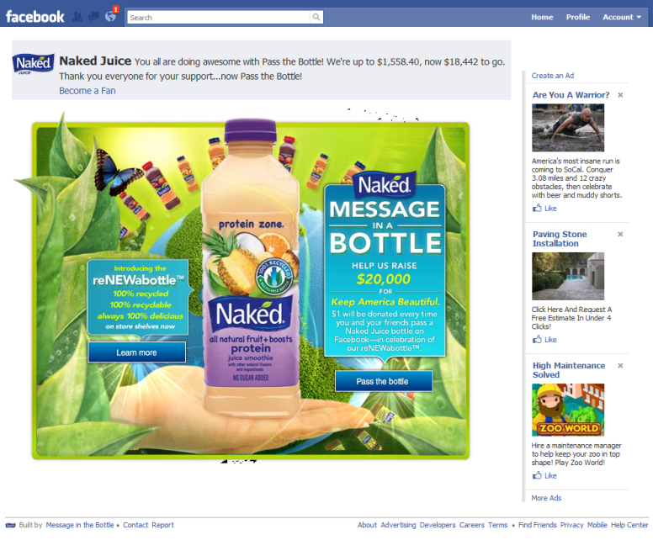
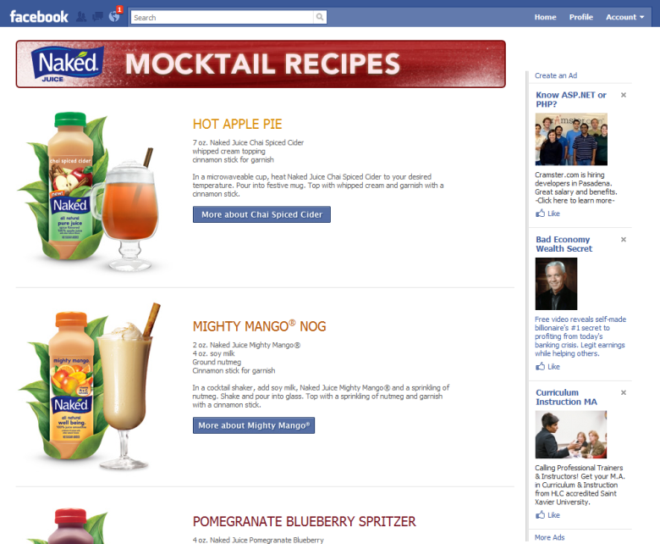
Example 4: Custom Applications
Facebook Applications
Range of applications built through the facebook platform that allows for games, quizzes, contests, etc.

Slide 7
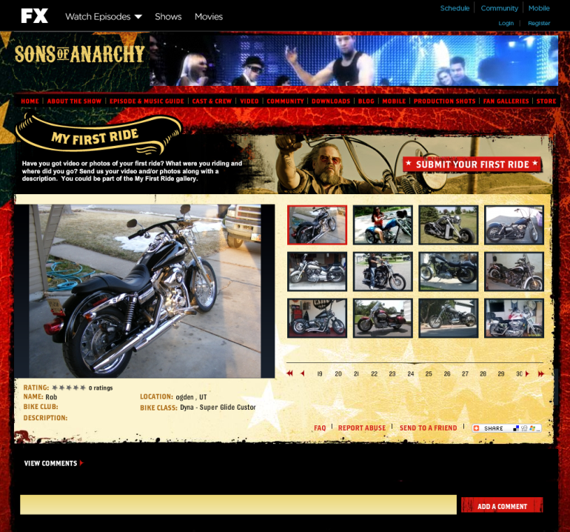
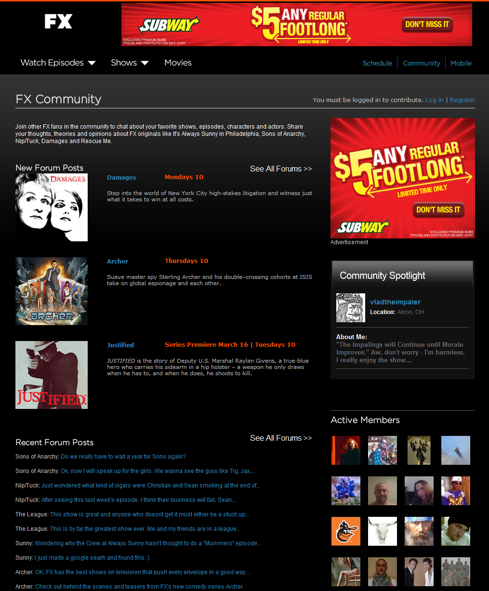
Example 5: Social Platforms
Implement and customize 3rd party solutions
Pluck
Kickapps
Out of the box widgets and/or custom APIs

Slide 8
Major Technologies
Things BLITZ Knows
Facebook
Applications
Open Graph (formerly FB Connect)
Commenting & Sharing
Twitter
Digg
Utilize as CMS and push/pull content
Myspace
YouTube
Kickapps
Pluck
Hosted social platform
Things BLITZ Doesn’t Know
Facebook
Zillion apps
Long list of other social networks and platforms
bebo, friendster, ning, etc

Slide 9
Facebook
Facebook Applications
Live in the Facebook.com environment
Multi-purpose apps that range from games to quizzes to contests
Can utilize a variety of technologies including Flash, javascript, PHP, etc.
Open Graph
Live in the client site but allows access to Facebook info
Share registration info to simplify signup and login
Facebook comments module plug-in
Get user info, photos, and related friends
Share content to user or friends stream able to attach images, videos, music, links, etc.
Facebook fanpage
Post to users facebook stream regularly
Facebook events
Invite users to events and reminders of key dates
Can be utilized within facebook or setup with facebook connect from client site.
Challenges
Some development quirks in their APIs
Constantly adding/removing features, API calls, etc.

Slide 10
Twitter
Customize and create your own Twitter page.
API for custom implementation
Search for tags/keywords/hash
Update/Show/Delete status
Get profile info of users
Direct Message followers
Challenges
API rate limiting(REST API is 150 requests per hour)
Authentication(Oauth, Basic Authentication)

Slide 11
Digg
Discover and share content from anywhere on the web
Rest-like API to get content based on search, user digg, topics, time frame, etc.
Get comments, bury, digg stories.
Challenges
No built in moderation for results
Some actions require Oauth authorization

Slide 12
Myspace
YouTube
Create myspace branded page
More customization, embed flash, videos, music, etc.
Poor sharing options
Less structured/less restrictive
Create customized YouTube channel with subscribers
Push/pull video content
API in javascript/AS3 gives you customized control of videos.

Slide 13
Pluck
Out of the box social platform widgets
Forum
Profile Pages
Comments/Reviews
Blogs
Moderation workbench
Javascript API for custom calls to develop social networking tools for client site.
Photo gallery
Video gallery
Challenges
Monthly Hosting fee and contract
API is cumbersome and time consuming to implement.

Slide 14
Thoughts?
What Industries / Clients does the work for?
Almost Any
Any Ideas?
Facebook Connect integrated with user registration(FX, Activision, etc)
Add UGC and social apps through Pluck API to Naked Juice.

